Slide 1
Is forest a pharmacy?
Marcin K. Dyderski
Institute of Dendrology, Polish Academy of Sciences
Poznań University of Life Sciences, Department of Game Management and Forest Protection
scientific supervisor: dr. Andrzej M. Jagodziński

Slide 2
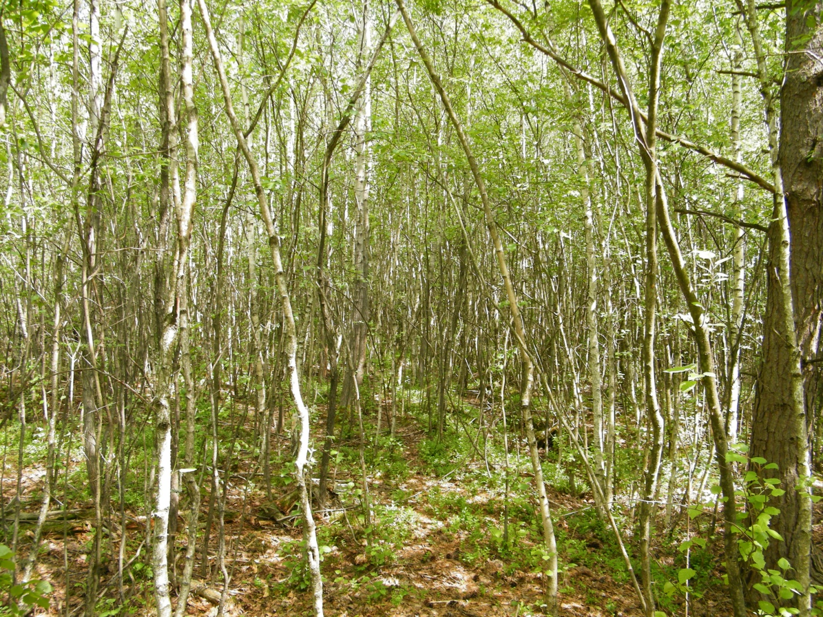
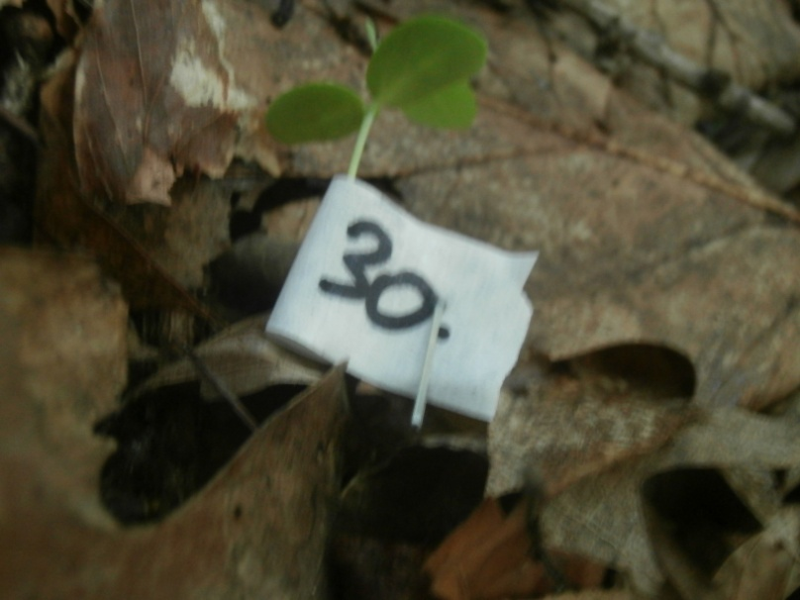
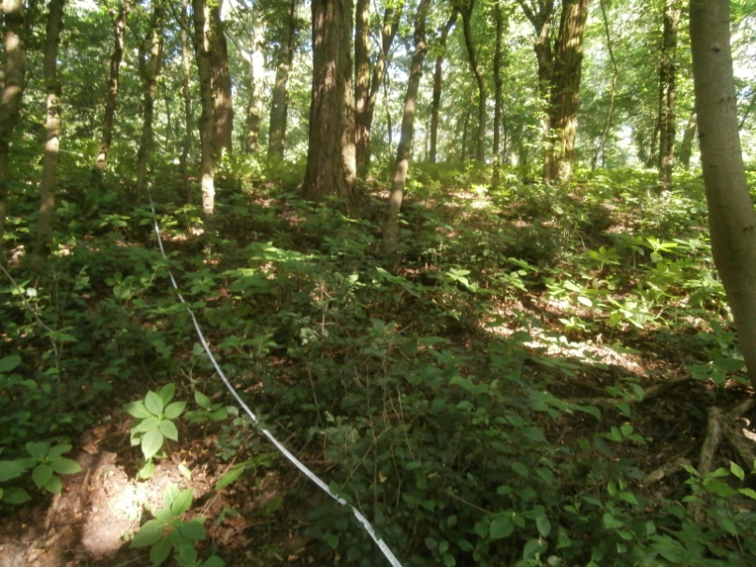
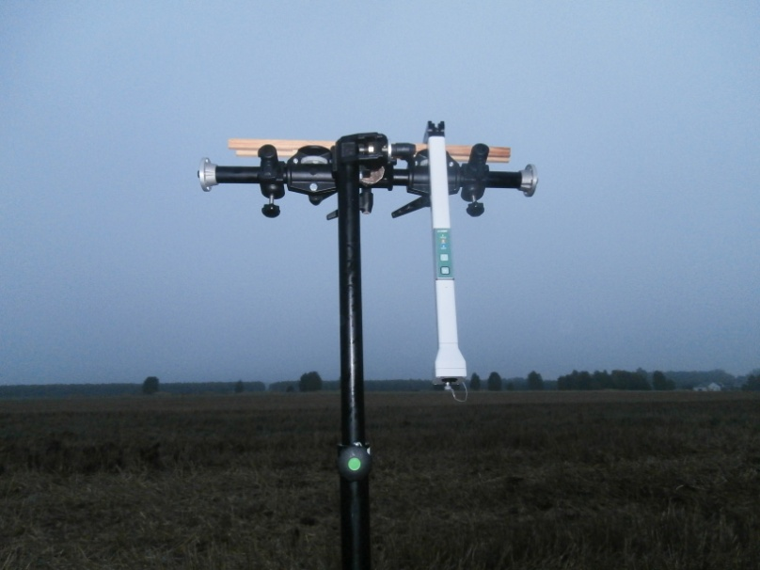
forest ecology

Slide 3
foRest ecology

Slide 4
Aims of the presentation
to show analytical problems typical to forest ecology and its solutions in R
to consider place for data science in forest ecology

Slide 5
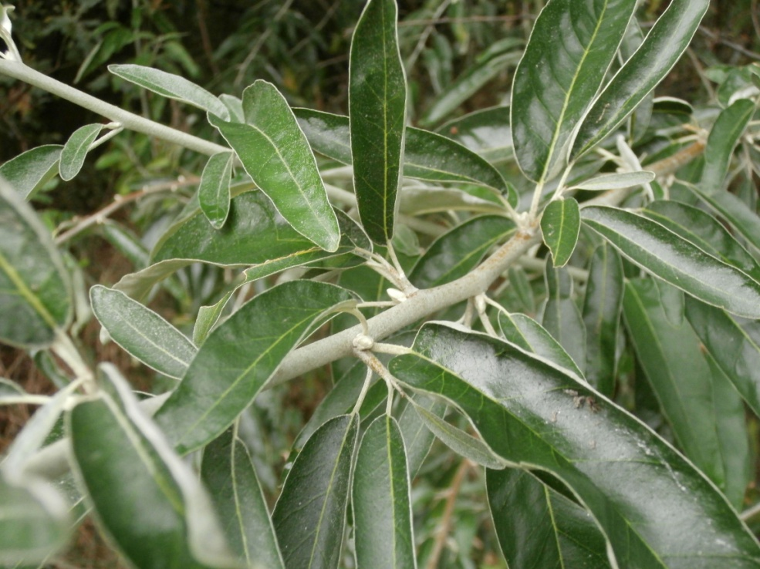
Primary production patterns
plants are producing biomass
how much?
how long?
when?
why?
...

Slide 6
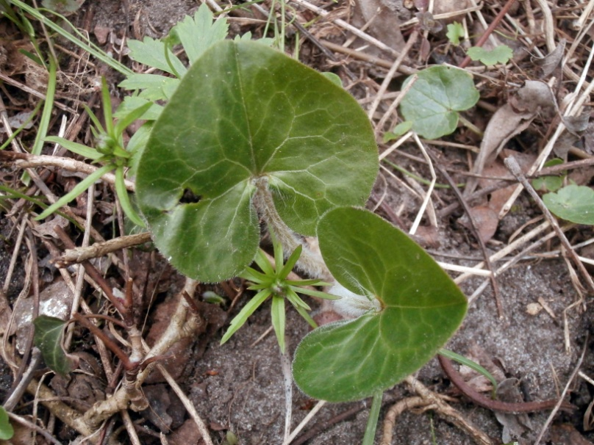
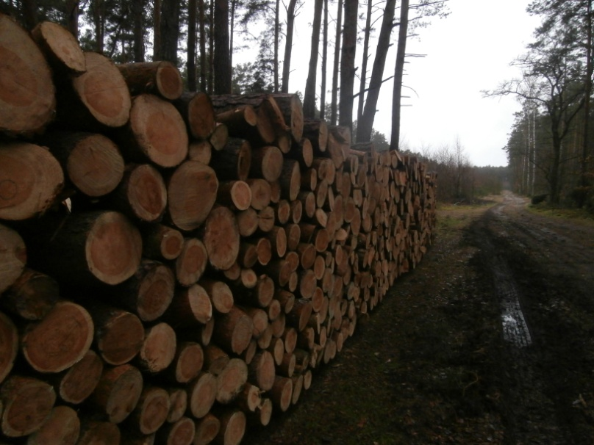
Why biomass?
carbon retention
best measure of plant’s success
utilisation (e.g. wood or food)

Slide 7
Data analyzes
in total: 2429 plants
12 understory herb species
14 dates of harvest
three parameters:
Specific Leaf Area
Total leaf area
Biomass of individual
uneven time of emergence:
spring ephemerals
species present during the whole growing season
unknown variablity

Slide 8
Possible approaches
linear model
data mining, e.g. SVM
two-way ANOVA: e.g. SLA ~ harvest time * species
exploratory data analyzes + one-way ANOVA – species case studies and looking for patterns

Slide 9
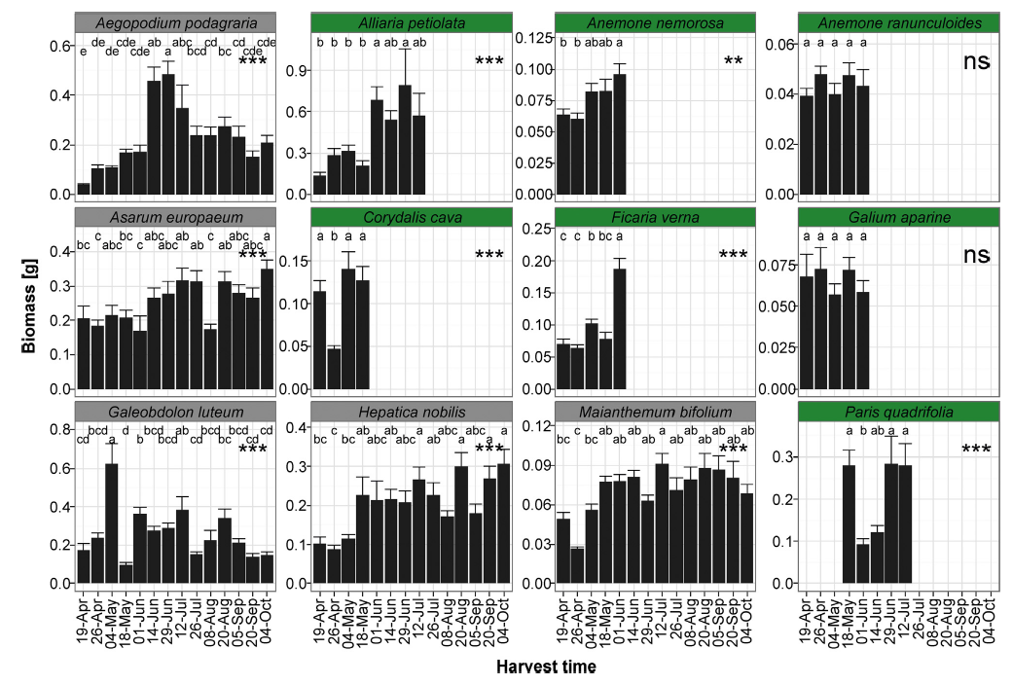
Jagodziński et al. 2016; Forest Ecology and Management 374

Slide 10
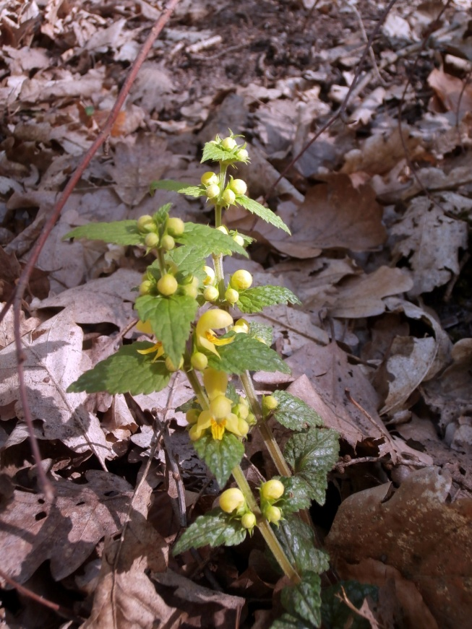
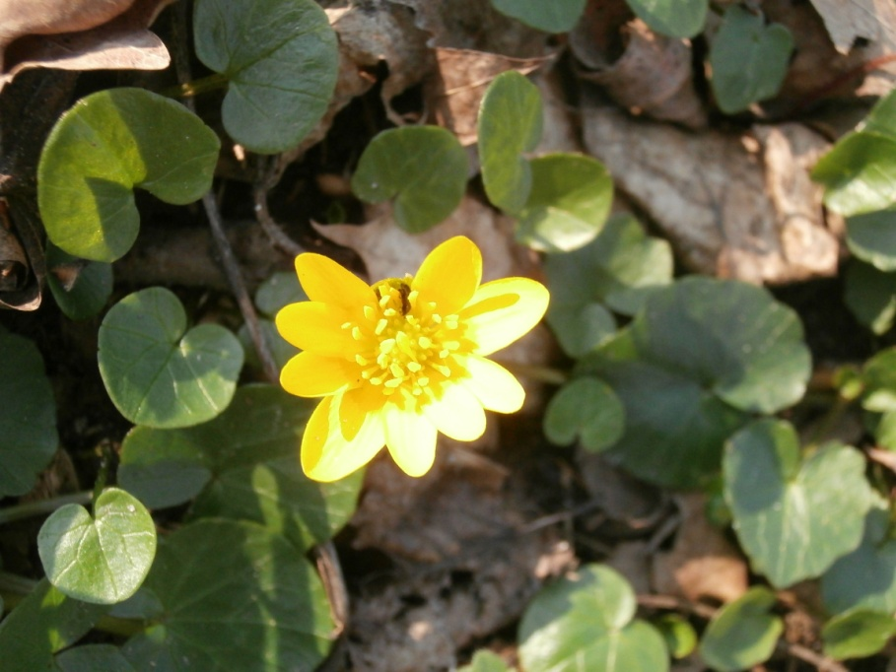
Multiple comparisons?
each species is a separate story
due to different life strategies

Slide 11
Caution needed
always plot your data before cleaning
knowledge about range of variables
come from field and lab work
and lead to answer whether it is a mistake or natural variability
thus we need to caution and put effort into proper measurements

Slide 12
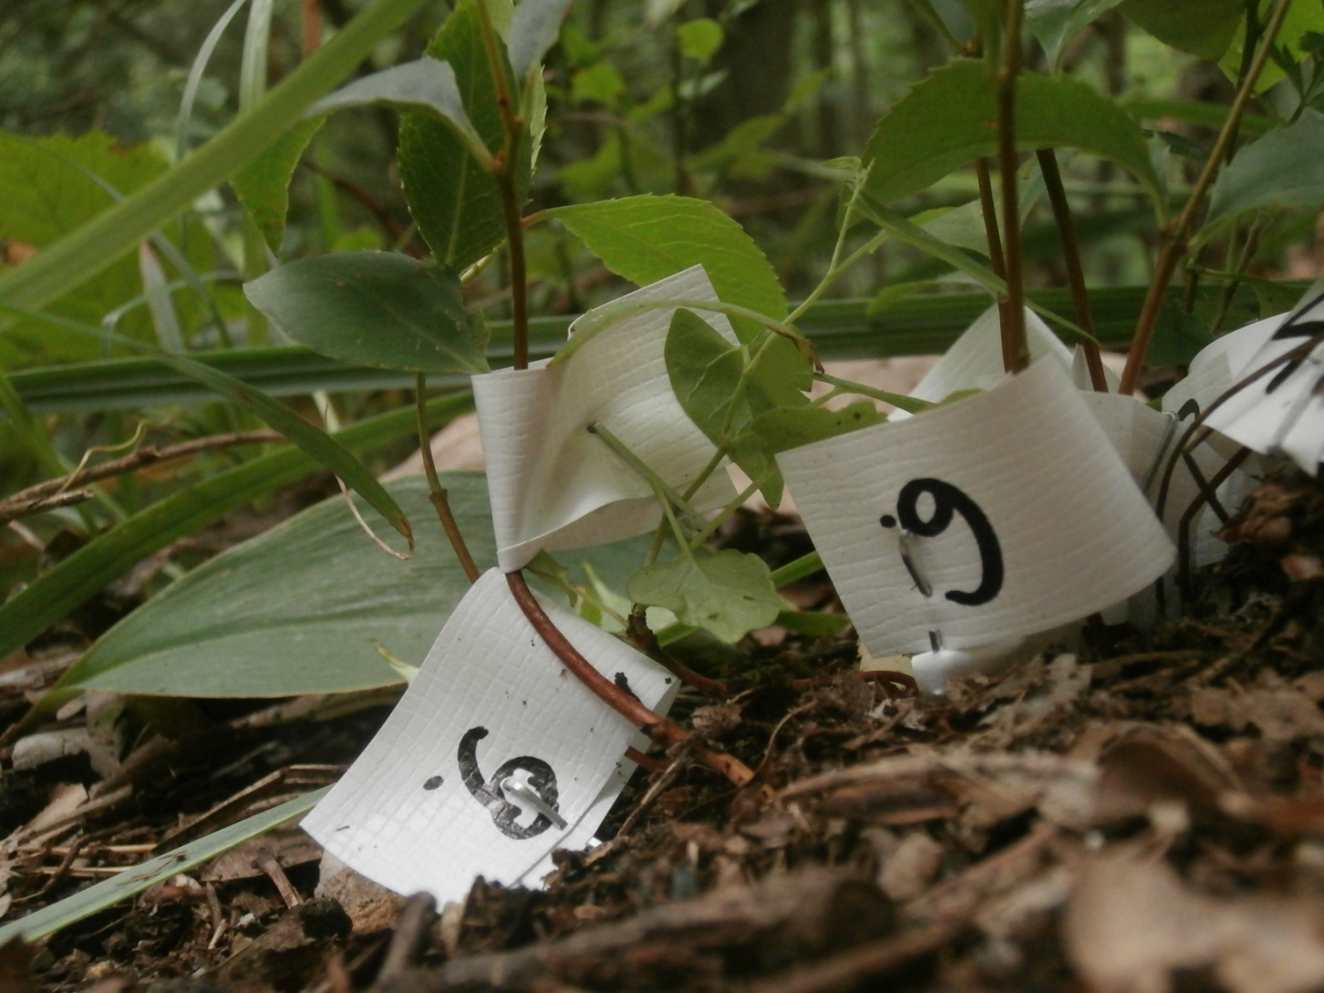
Natural regeneration – zero problem?

Slide 13
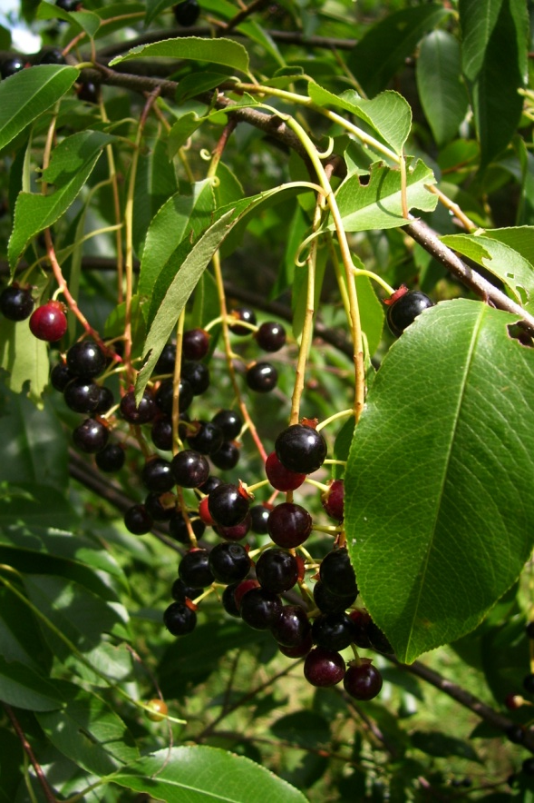
Case study – Rogów Arboretum
invasive black cherry
20,843 counted plants
few explanatory variables:
distance from the seed source
type of tree stand

Slide 14
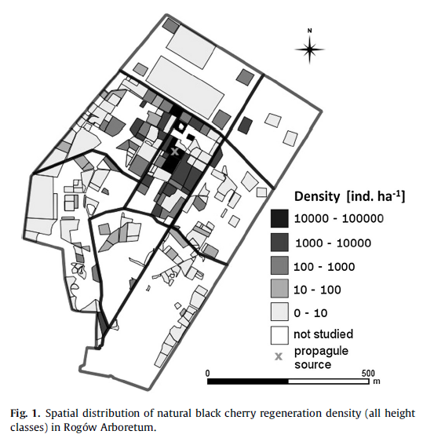
Problem
how type of tree stand modifies relationship between distance from seed source and density of black cherry
Jagodziński et al. 2015; Forest Ecology and Management 357

Slide 15
It sounds easy, but...
how it is meaningful?
what is more important – density or presence?
how to model it?
what is an outlier in this case?

Slide 16
Caution needed – outliers
suitable microhabitat
density of adult (fruiting) trees
clustered group of seedlings conncected with random clustering
dispersion by birds – faces full of seeds

Slide 17
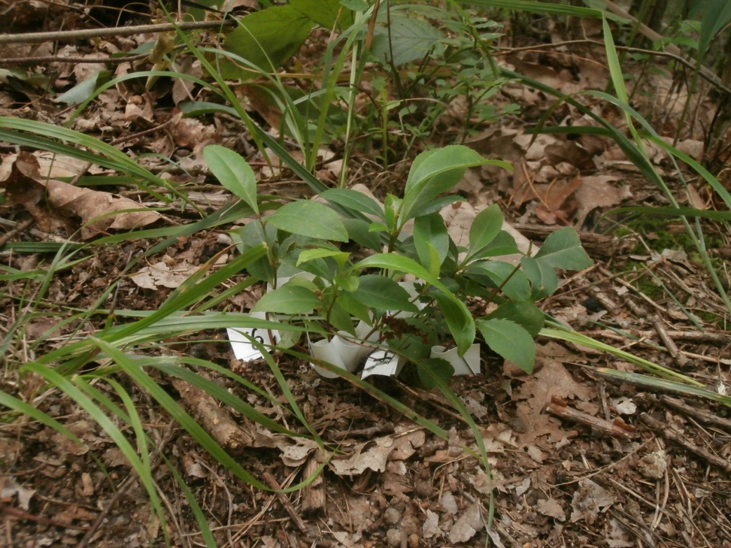
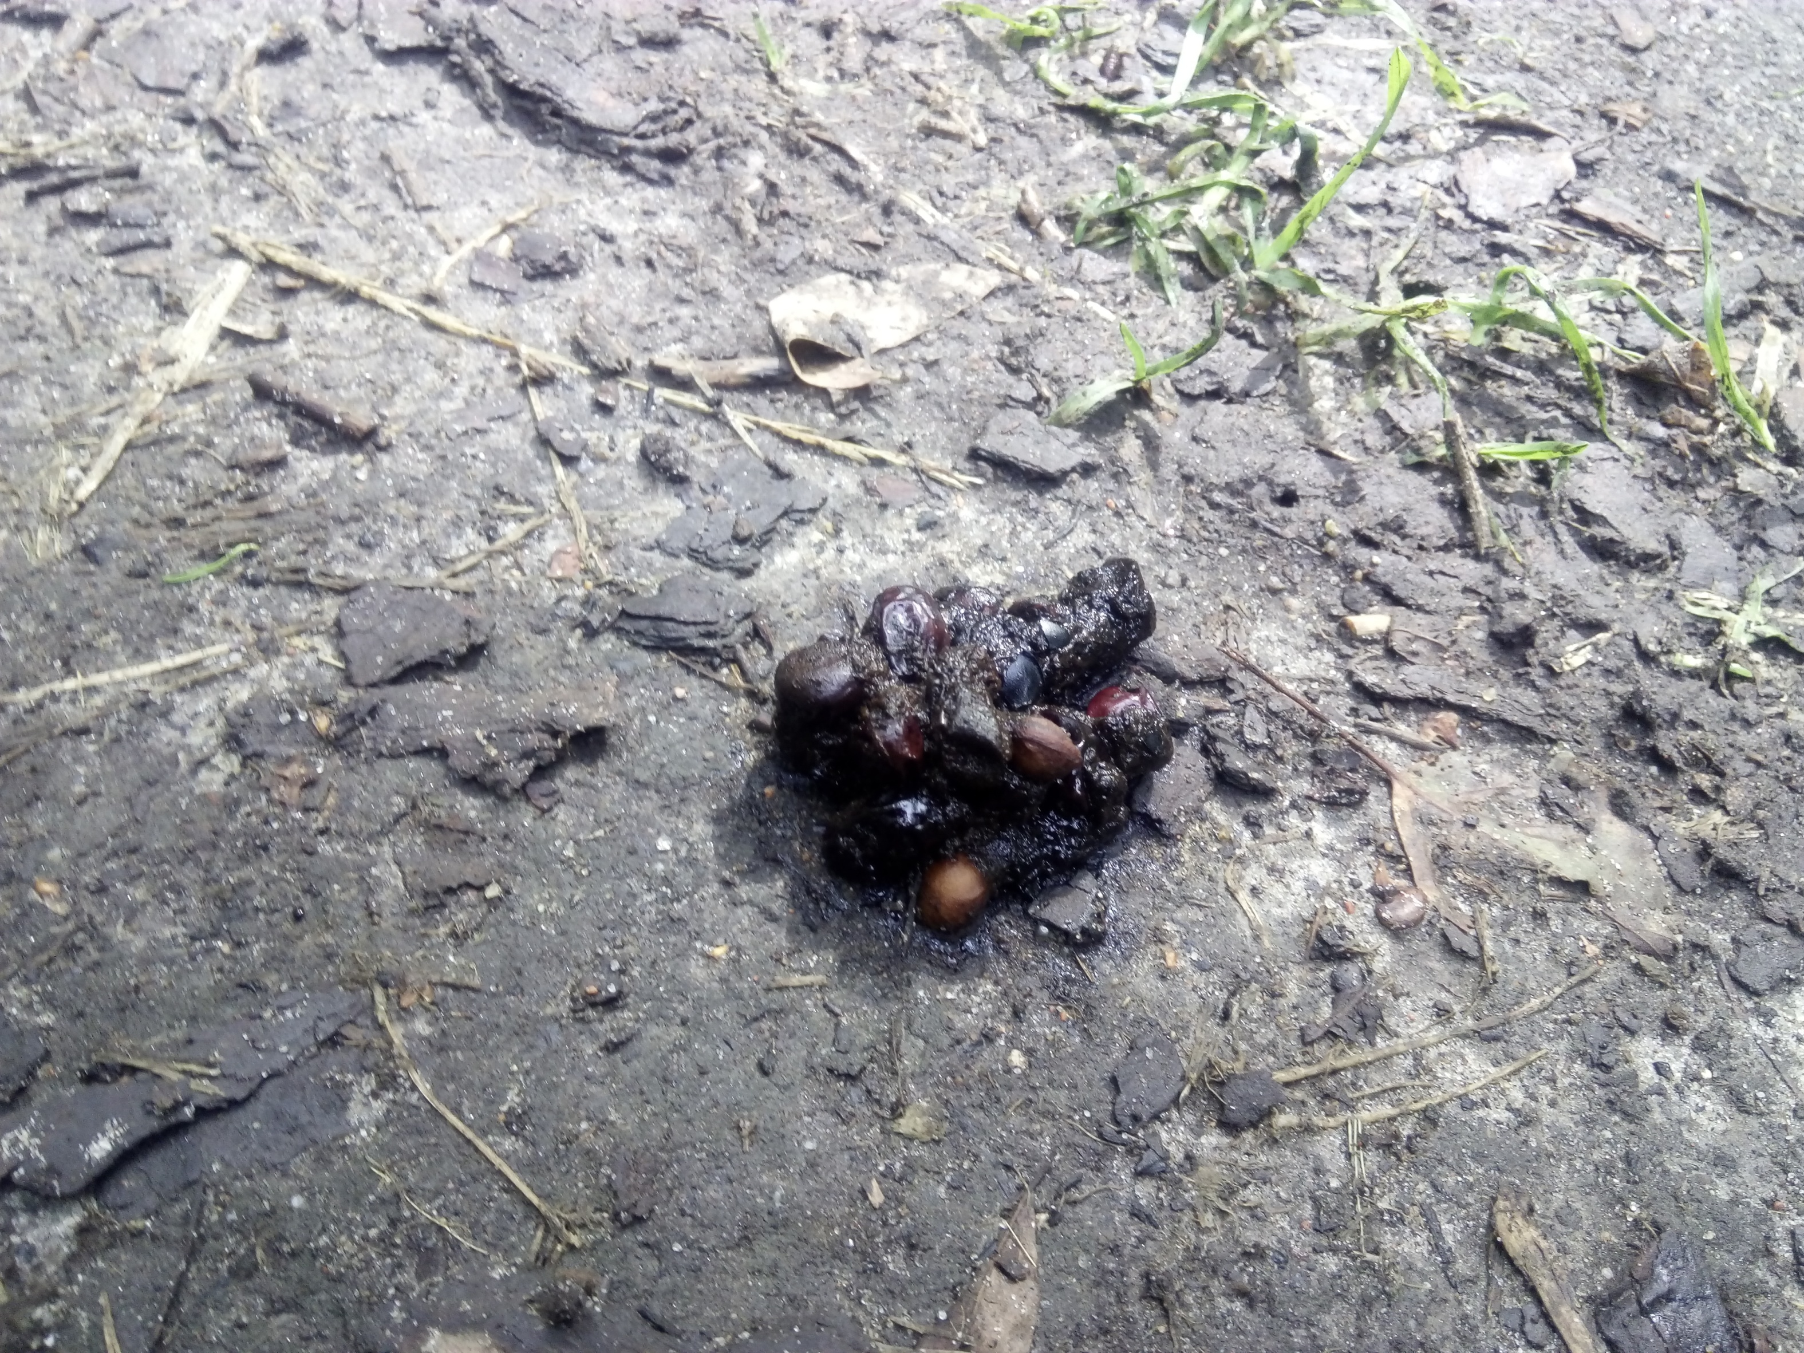


Slide 18
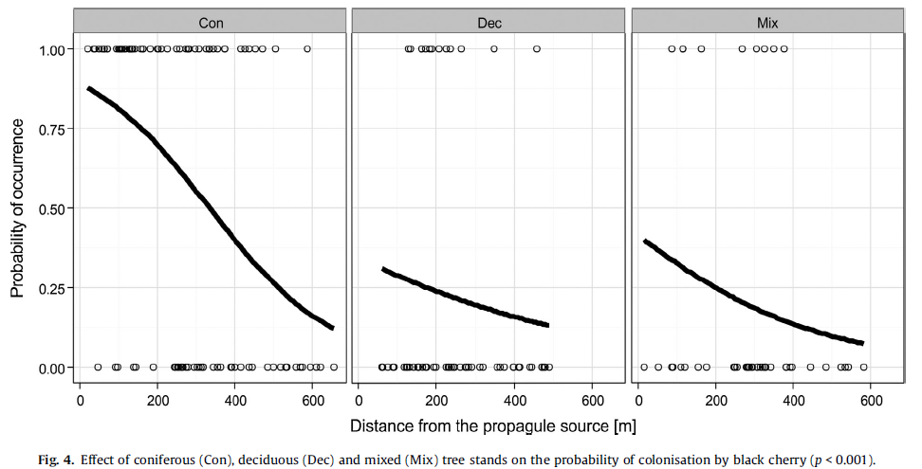
Effect size and interaction
Jagodziński et al. 2015; Forest Ecology and Management 357

Slide 19
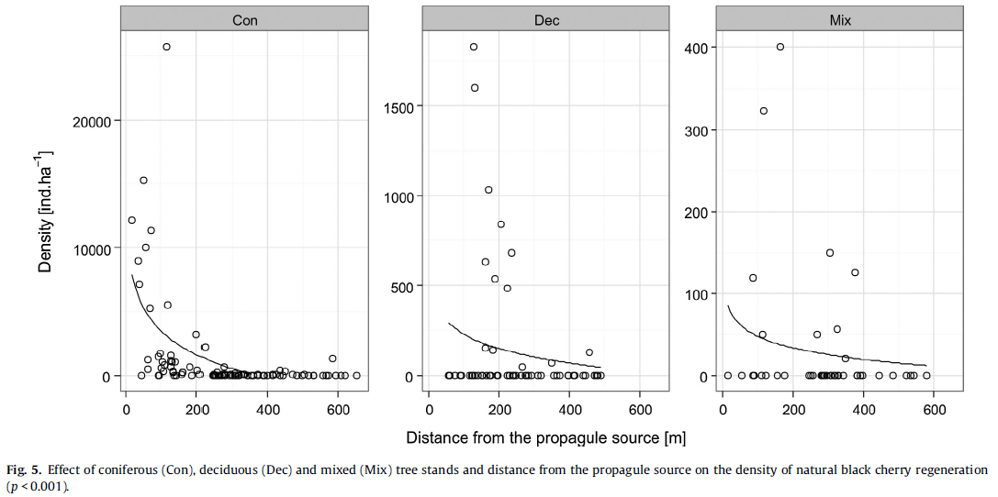
Effect size and interaction
Jagodziński et al. 2015; Forest Ecology and Management 357

Slide 20
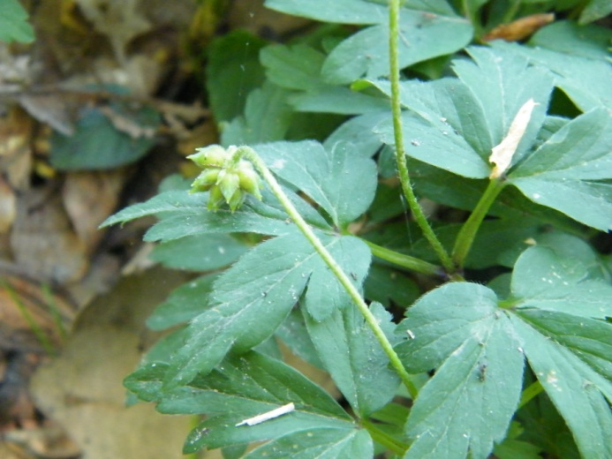
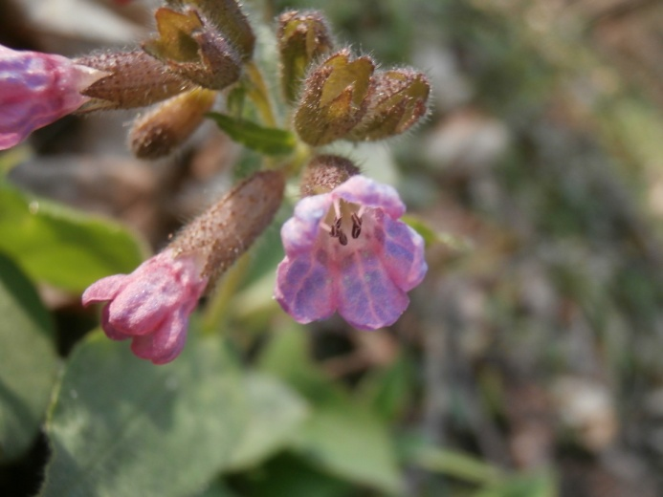
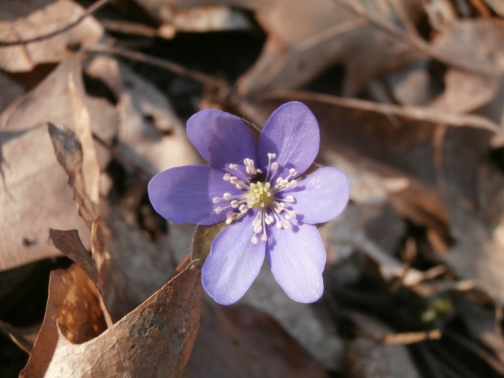
Impact of urbanization on flora
Ancient Woodland Indicator Species (AWIS)
statistically significantly more frequent in old forests
but... are they good bioindicators?

Slide 21
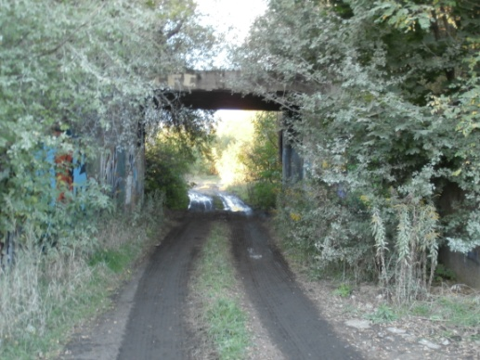
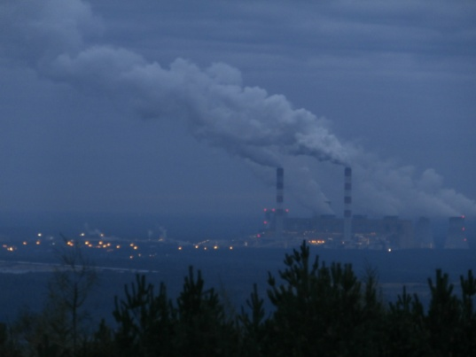
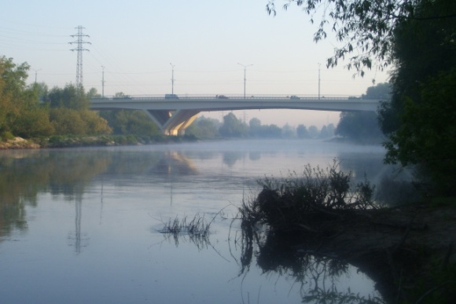
Why AWIS are doubt?
AWIS enter cities, dumps, spoil heaps and other „new forests”
even these seriously threatened may be found in the ‘rubbish forests’

Slide 22
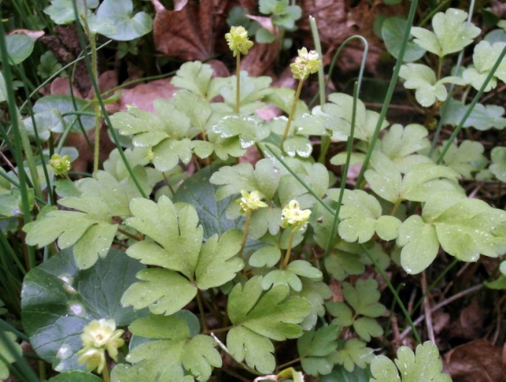

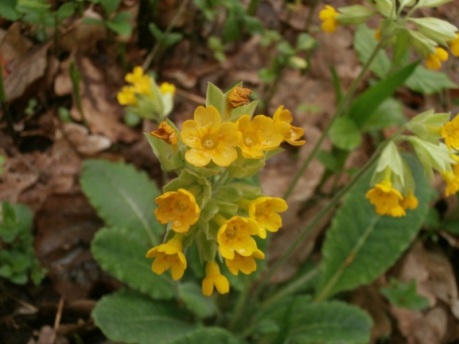
Questions
are AWIS really connected with old forests in urban areas?
if yes, how they respond to land-use forms (CORINE Land Cover)?

Slide 23
Data
mainly published data on 79 AWIS occurences (n=1589)
grid squares 1 km²
time extent of database: 35 y
Dyderski et al.; submitted to Diversity and Distributions

Slide 24
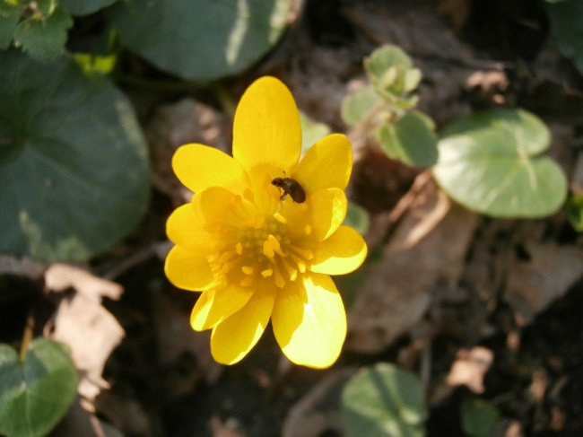
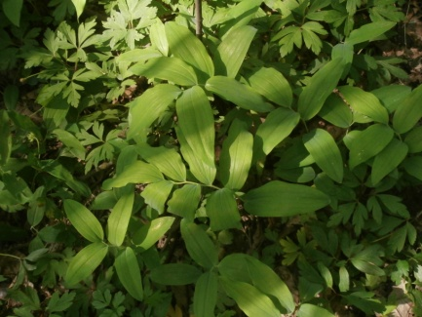
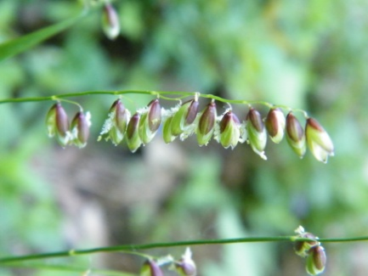
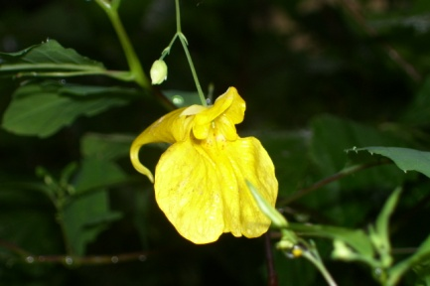
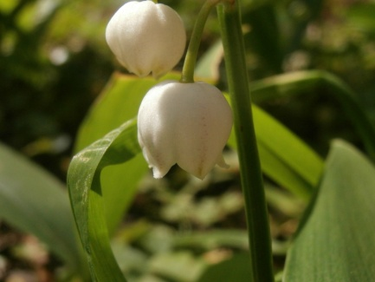
Analyzes
how to check every species fidelity?
most of them – confirmed fidelity
Presence | Old forests | New forests | Without forests
YES | 21 | 14 | 20
NO | 23 | 39 | 125
Χ² = 22.66; p<0.001 – pattern confirmed

Slide 25
Visualisation
Dyderski et al.; submitted to Diversity and Distributions

Slide 26
How to check whether differences between old and new forests are important?
simple:
one-way ANOVA
base package
sophisticated:
spatially-explicit Poisson GLM
hglm package
+ spdep – for neighbourhood matrix

Slide 27
Result: the same or not?
Dyderski et al.; submitted to Diversity and Distributions

Slide 28
AWIS number vs. land-use forms
Dyderski et al.; submitted to Diversity and Distributions

Slide 29
Land-use forms
Dyderski et al.; submitted to Diversity and Distributions

Slide 30
Are railways really nice for AWIS?
Prussian stronghold
railways from XIX century
forests planted for forts protection
= coincidence

Slide 31
Conclusions
forest ecology needs data science
‘expert knowledge’ about species and ecosystems is required to distinguish computation artifacts from biological phenomena
many problems are solvable by easy methods, but require lot of data
many problems don’t require hard-to-collect data, but require analytical skills

Slide 32

Conclusions
forest ecology needs data science
data science for forest ecology must be more expert knowledge-oriented to fulfill its aims
http://drewconway.com/zia/2013/3/26/the-data-science-venn-diagram

Slide 33
Conclusions
forest ecology needs data science
data science for forest ecology must be more expert knowledge-oriented to fulfill its aims
http://drewconway.com/zia/2013/3/26/the-data-science-venn-diagram

Slide 34
Is forest a pharmacy?
Marcin K. Dyderski
Institute of Dendrology, Polish Academy of Sciences
Poznań University of Life Sciences, Department of Game Management and Forest Protection
scientific supervisor: dr. Andrzej M. Jagodziński

